Slide 1

EXPLORATORY DATA ANALYSIS OF TELANGANA MAHALAKSHMI FREE BUS RIDE SCHEME

Slide 2
ABOUT ME –
B . MANASA
MCA – 2024
With my MCA background , I’m drawn to data science because it empowers me to turn raw data into smart solutions that can actually impact people’s lives.
LinkedIn – LinkedIn Profile
GitHub - Git Profile

Slide 3
PROBLEM STATEMENT – OBJECTIVE -
To analyze the public response, usage patterns, and overall impact of the Telangana Mahalakshmi Free Bus Ride Scheme. This includes evaluating changes in travel frequency, user satisfaction, cost savings, and accessibility, particularly among women commuters, following the scheme’s implementation
The primary objective of this project is to evaluate the impact of the Telangana Mahalakshmi Free Bus Ride Scheme on public transportation usage. It aims to analyze changes in travel behavior, frequency, and satisfaction among commuters—before and after the scheme's implementation. The study also seeks to estimate financial savings, assess public support, and identify trends across demographics such as age, district, and travel distance. Through data-driven insights, the project supports a better understanding of the scheme’s effectiveness and areas for improvement.

Slide 4
DATA SOURCE – SUMMARY OF DATA –
Primary data was collected through a custom-designed Google Form targeting Telangana residents.
The dataset consists of 166 records and 25 fields.
There are 4 numerical columns and 21 categorical columns
Datatypes of columns include int , object types .
The 4 numerical columns describes the age , Fare change , satisfaction before , satisfaction after
The 21 categorical columns describes the gender , resident , district , ever_travelled , freq_before , freq_after , purpose , freq_route , freq_cross , fare_before , fare_after , pass_applied , pass_before , pass_change , range , spent_before , freq_famfrnds , savings , wait_before , wait_after , opinion.

Slide 5
FIELD DESCRIPTION –
Resident -Identifies whether the respondent is a local resident, which helps filter relevant responses.
Gender - Used to analyze gender-specific trends, especially important as the scheme targets women.
Age - Categorizes respondents into age groups to compare usage and satisfaction patterns.
District - Captures geographic distribution to assess reach and impact across regions.
Ever_travelled - Checks prior experience with the service to understand the respondent's baseline familiarity.
Freq_before - Analyzes how often people used state buses before the scheme started.
Freq_after - Measures changes in bus usage since the scheme was introduced.
Purpose - Reveals the main reason for using buses, such as work, education or personal errands.
Freq_route - Determines consistency vs variety in travel patterns
Freq_cross - Evaluates how often respondents travel across districts or states.
Fare_before - Estimates the typical cost incurred before the scheme for travel.

Slide 6
FIELD DESCRIPTION –
Fare_after - Estimates the typical cost incurred after the scheme for travel.
Fare_Change - Captures perception or knowledge of fare adjustments post-scheme.
Pass_Applied - Gathers information on usage of passes, which may impact cost.
Pass_before - Understands previous monthly bus pass costs for comparison.
Pass_change - Analyzes cost savings for pass holders post-implementation
Freq_famfrnds - Expands analysis to household or community-level impact.
Range - Classifies travel type for distance-based usage patterns
Spent_before - Captures the typical amount respondents spent on bus travel before the scheme
Savings – Calculates the financial benefit perceived by users.
Wait_before – the average waiting time for a bus before the scheme was introduced.
Wait_after – the average waiting time for a bus after the scheme was introduced.
Satisfaction_before - Indicates user satisfaction with TSRTC services before the scheme.
Satisfaction_after - Shows user satisfaction levels after the scheme was implemented.
Opinion - Captures public support, neutrality, or opposition to the initiative.

Slide 7
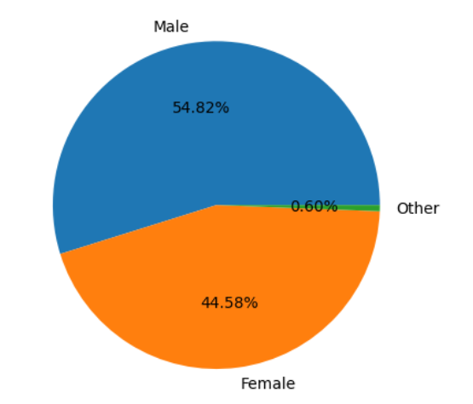
DATA CLEANING – UNIVARIATE ANALYSIS – GENDER DISTRIBUTION
No missing values , no duplicate values are found in the dataset
Using pie chart as it is easy to compare the proportions
Among all respondents, 54.82% are male, 44.58% are female, and 0.60% identify as other.

Slide 8
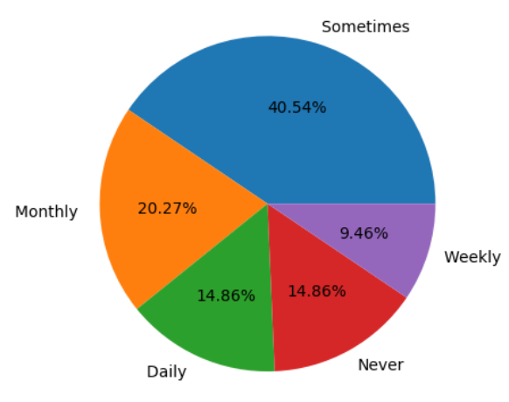
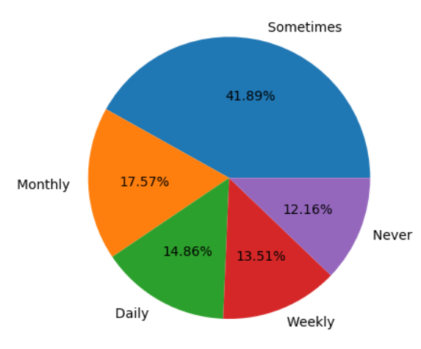
- Female travel frequency pre and post scheme
Daily travel frequency: Remained unchanged.
Weekly travel frequency: Increased by 4.05%.
Monthly travel frequency: Decreased by 2.7%.
Occasional travel frequency : Increased by 1.35%.
Overall impact: Scheme potentially led to more frequent bus use (weekly) and less monthly travel among women.

Slide 9
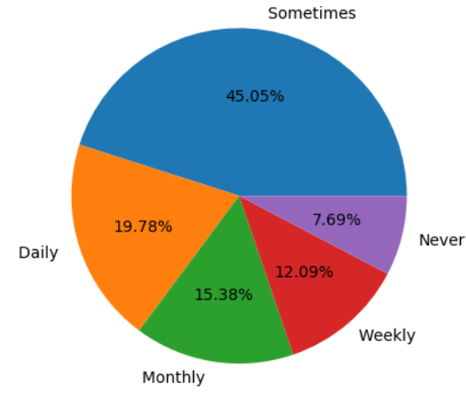
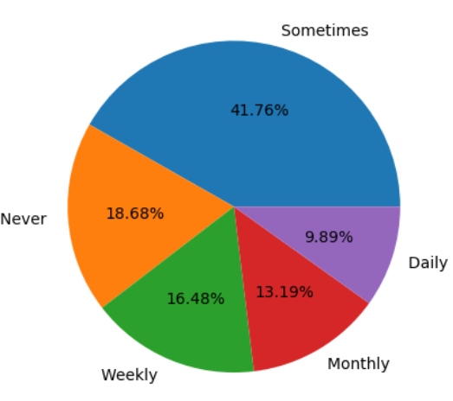
- Male travel frequency pre and post scheme
Daily travel frequency: Decreased by 9.89%.
Weekly travel frequency: Increased by 4.39%.
Monthly travel frequency: Decreased by 2.19%.
Occasional travel frequency : Decreased by 3.29%.
Overall impact: Scheme potentially led to less frequent bus use and slightly more weekly travel among men

Slide 10
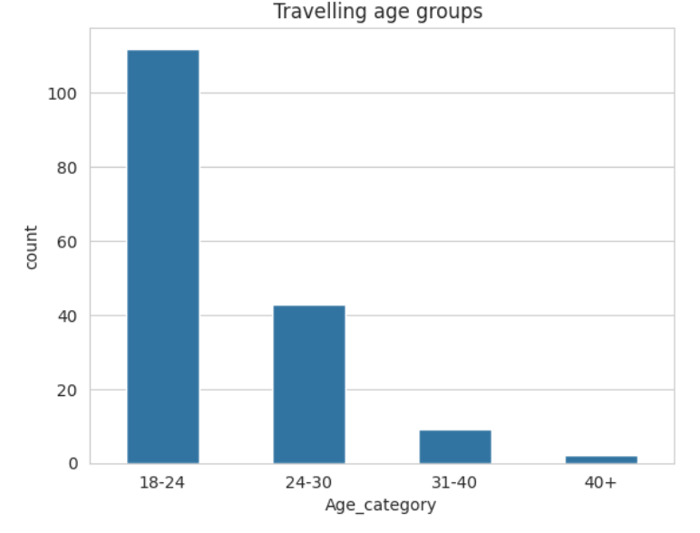
Age Distribution of Respondents-
Most respondents are young adults (18-24).
Significant groups: 24-30 and 31-40.
Fewer respondents are from 40+ and under 18.

Slide 11
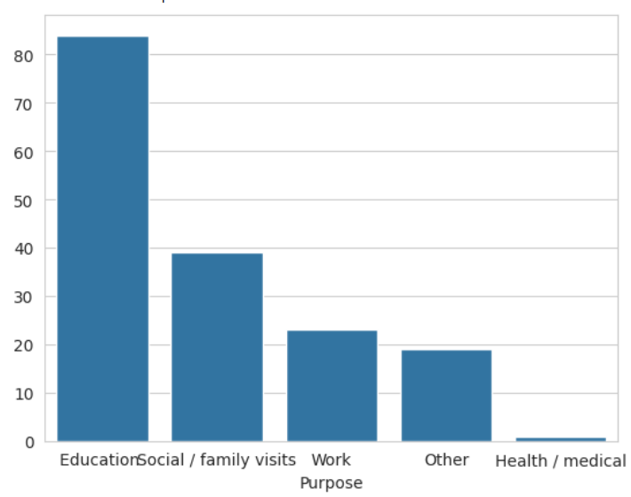
Travel Purpose Distribution
Education is the primary purpose of bus travel.
Social/Family Visits is the second most common reason.
Work, Shopping, and Medical are also reasons for travel.
Health/medical purposes are less frequent

Slide 12
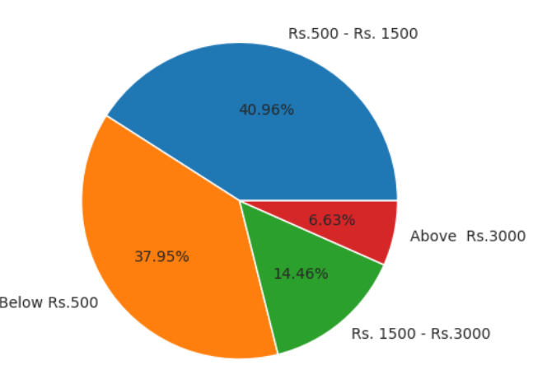
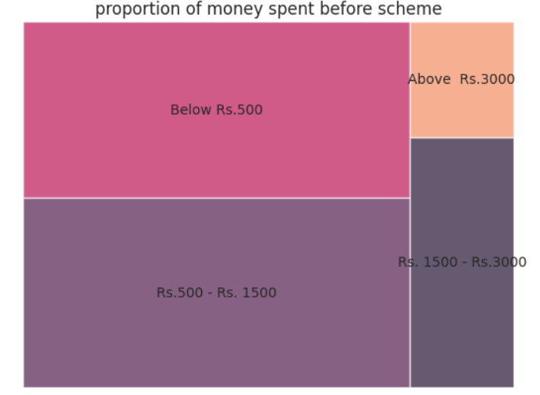
Travel Cost Distribution (Pre Scheme)
Largest group spent between 500-1500 per month.
Significant portion spent less than 500.
Fewer people spent between 1500-3000 or over 3000.
Spending is concentrated in the lower and middle ranges.

Slide 13
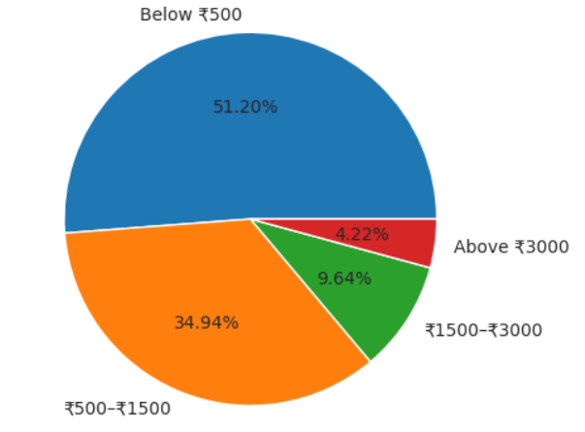
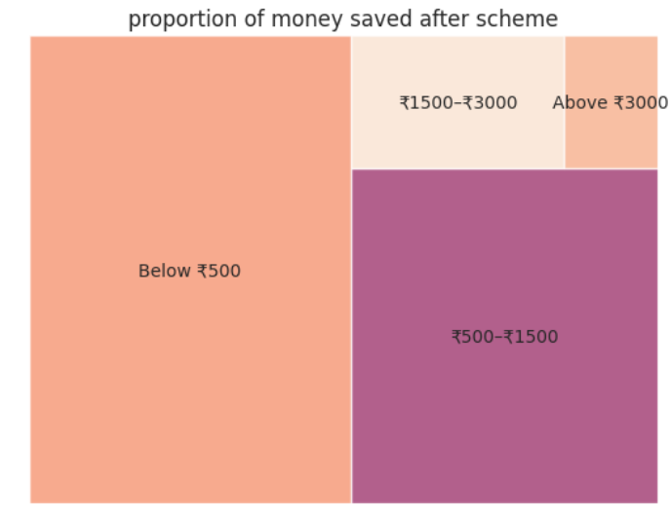
Money Saved on Bus Travel (Post Scheme)
Largest group saved less than 500 per month.
Significant portion saved between 500-1500.
Fewer people saved between 1500-3000 or over 3000.
Savings are concentrated in the lower and middle ranges.

Slide 14
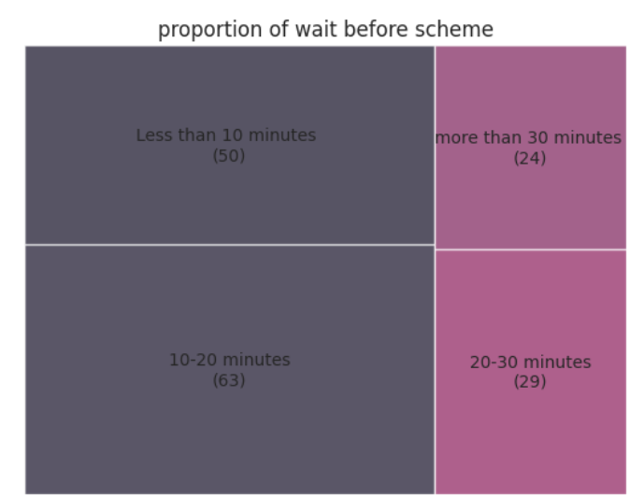
Time Spent Waiting for Bus (Pre Scheme)
"10-20 minutes" was the most common wait time.
"Less than 10 minutes" was also a significant category.
"20-30 minutes" and "More than 30 minutes" were less frequent.
Wait times were largely concentrated below 20 minutes.

Slide 15
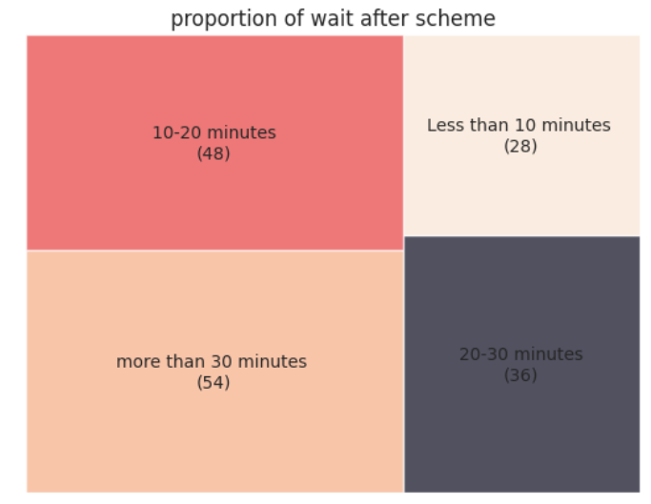
Time Spent Waiting for Bus (Post Scheme)
"More than 30 minutes" became a significant category.
"20-30 minutes" also increased in frequency.
"Less than 10 minutes" and "10-20 minutes" decreased in frequency.
There is a shift towards longer wait times after the scheme.
The scheme has seemingly shifted bus availability, with fewer experiencing short waits (<10-20 mins) and more facing longer waits (20-30+ mins), suggesting a potential trade-off in accessibility.

Slide 16
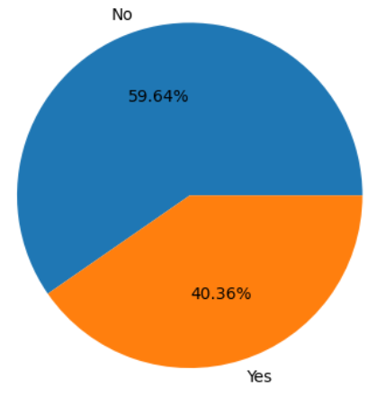
Pass Application Frequency
Less than half of the respondents (40.36%) have applied for a pass.
A majority of respondents (59.64%) have not applied for a pass.
The pass application rate among survey respondents is relatively low.

Slide 17
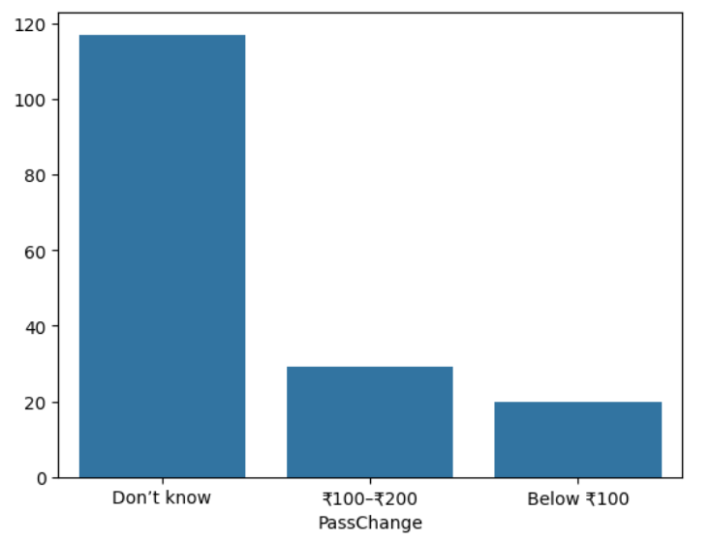
Bus Pass Fare Change (After Scheme)
The most frequent change in pass fares was between 100-200.
Changes below 100 were the next most frequent.
These findings indicate a noticeable shift in pass pricing after the scheme.

Slide 18
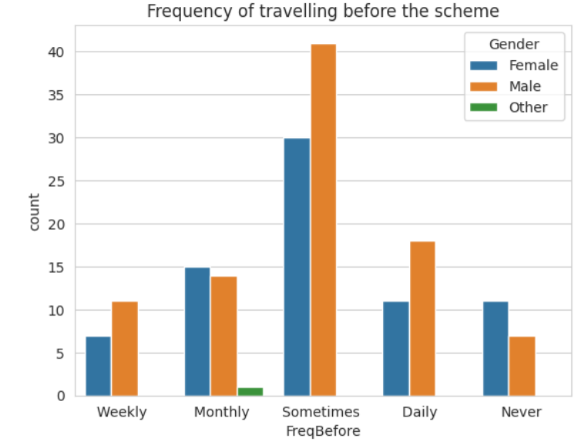
BIVARIATE ANALYSIS : Pre-Scheme Travel Patterns Across Genders
Men: Highest frequency was daily travel.
Women: More balanced across daily, weekly, and monthly travel.
Both: Weekly and monthly travel were significant

Slide 19
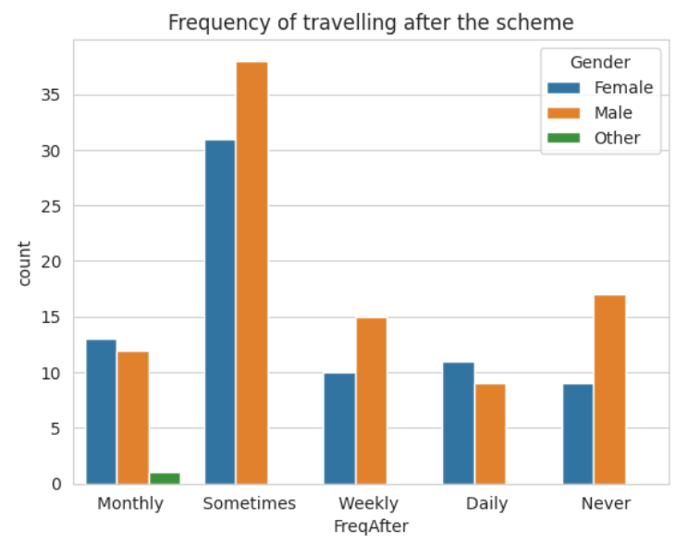
Post-Scheme Travel Patterns Across Genders
Men: Daily travel decreased, weekly increased.
Women: Daily travel stable, weekly increased.
Both: Monthly travel decreased.
Overall: Shift from daily/monthly towards weekly travel, particularly for men.

Slide 20
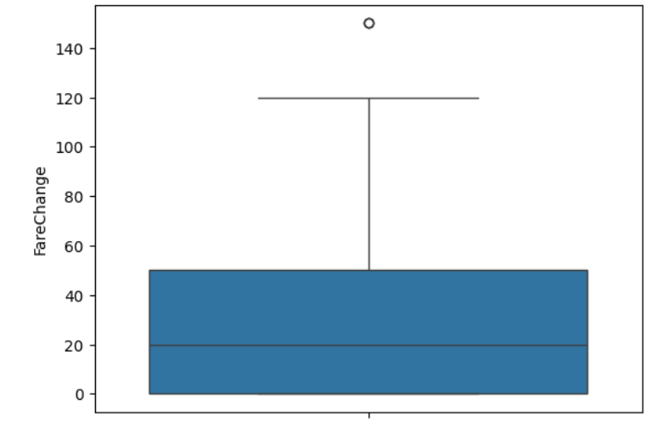
Impact on Bus Fare (After Scheme)
Most people reported a price change after the scheme.
A small group reported no change.
The fare changes generally range between 0 and 120.
There is an outlier at 150, indicating a larger fare change for some.
The scheme resulted in noticeable changes in bus fares for many travelers.

Slide 21
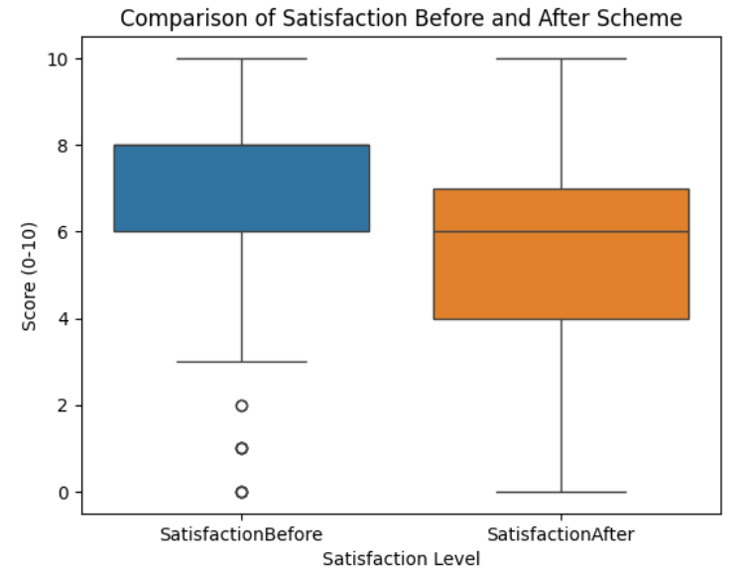
Impact of Scheme on Satisfaction
Satisfaction before the scheme was generally higher, centered between 6 and 8.
After the scheme, satisfaction scores shifted lower, centering around 4 to 7.
The range of satisfaction scores is wider after the scheme (from 0 to 10), compared to
before (mostly 6 to 8).
The scheme appears to have led to a potential decrease in user satisfaction.

Slide 22
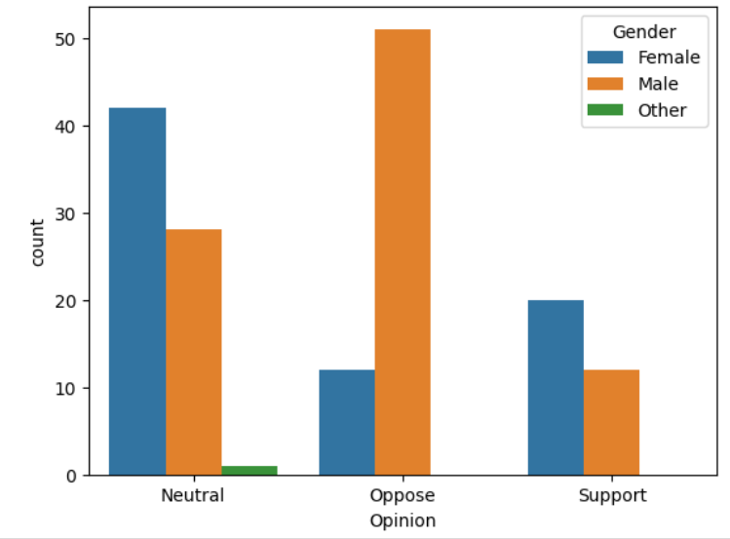
Scheme Opinion by Gender
A majority of men surveyed oppose the scheme.
Women are more likely to have a neutral opinion compared to men.
Among women, support for the scheme is higher than opposition, but neutral is the
largest category.
There is a clear difference in opinion on the scheme between genders.

Slide 23
INSIGHTS–
Female weekly travel increased significantly after the scheme.
Male daily travel decreased significantly after the scheme.
Weekly travel increased and Monthly travel decreased for both genders.
Education and social visits are the primary reasons for travel.
Most travelers spent between 500-1500 before the scheme.
Most travelers saved less than 500 after the scheme.
Wait times increased, with more people waiting over 20 minutes after the scheme.
The scheme shifted bus availability, increasing longer waits.
Overall satisfaction appears to have decreased after the scheme.
Men tend to oppose the scheme more than women.
Women are more likely to be neutral or supportive of the scheme than men.

Slide 24
CONCLUSION-
The Telangana Mahalakshmi Free Bus Ride Scheme has a mixed impact. It increased weekly bus travel for both genders and provided financial savings, mostly in lower amounts. However, it decreased daily travel for men, reduced overall satisfaction, and led to longer wait times. There's also a gender difference in opinion, with men being more critical. The scheme's benefits are clear, but addressing operational issues and user satisfaction is crucial for future success.

Slide 25


